Slide 1
Bitcoin Prices: Predictors and Correlations
Erik Sandstrom

Slide 2
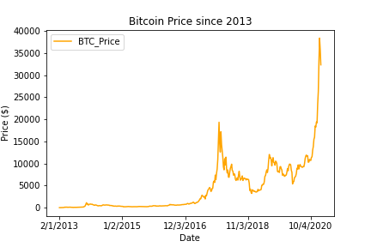
Blockchain
Brief history and overview
Originated 2009 after Financial Crisis
Distributed ledger
Perceptions of Bitcoin
Bitcoin is the brand name, but…
Possibilities are huge

Slide 3
Can Bitcoin Trends be Predicted?
How do Bitcoin prices respond to inflation?
Are people using Bitcoin as a hedge against uncertainty, inflation, regulation?
Are Bitcoin trends similar to gold trends?
Does Bitcoin mirror the stock market?

Slide 4
Hypotheses
Bitcoin prices respond to inflation
Investors use Bitcoin as a hedge against financial and economic uncertainty similar to how they use gold
Bitcoin and the stock market likely do not share a relationship, despite both climbing at increasing paces

Slide 5
So, what did I find?
Bitcoin and gold exhibit similar trends
No obvious relationship between Bitcoin and inflation (needs further, more complicated analysis)
Bitcoin appears to respond to some kinds of uncertainty
Surprising parallels with the stock market

Slide 6
Methodology
Ask questions, form hypotheses
Gather data
Clean and organize data
Calculations
Preliminary exploration
Targeted analysis
Draw conclusions, plan further exploration

Slide 7
Data Sources

Slide 8
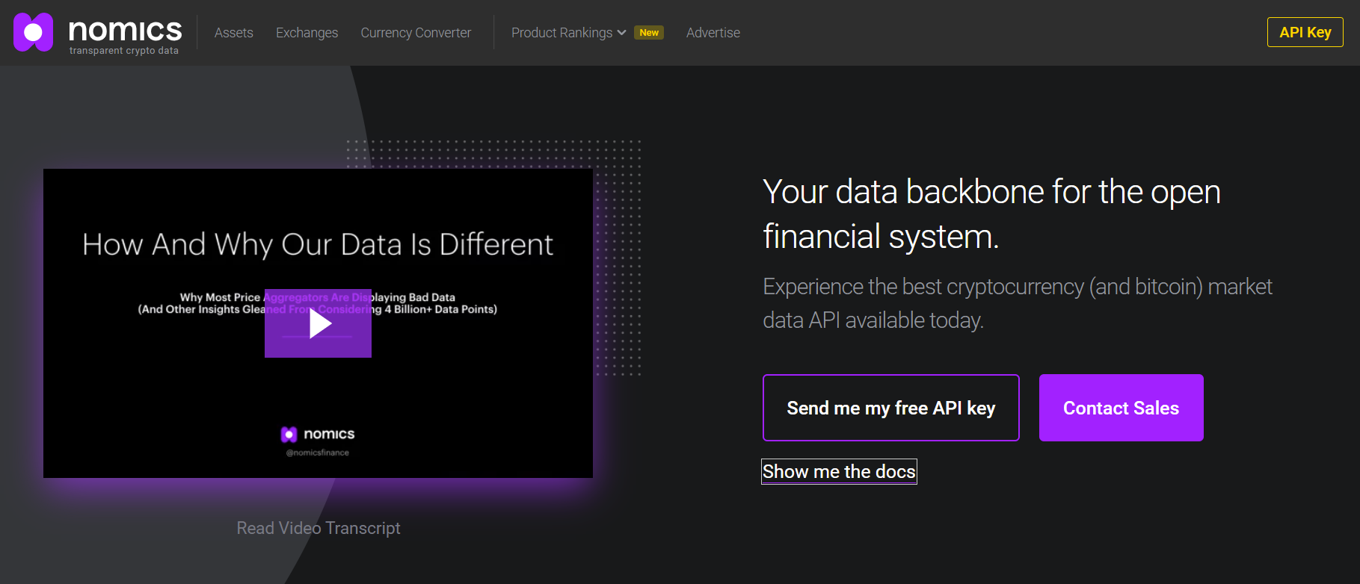
Nomics API
p.nomics.com
Daily Bitcoin Prices

Slide 9
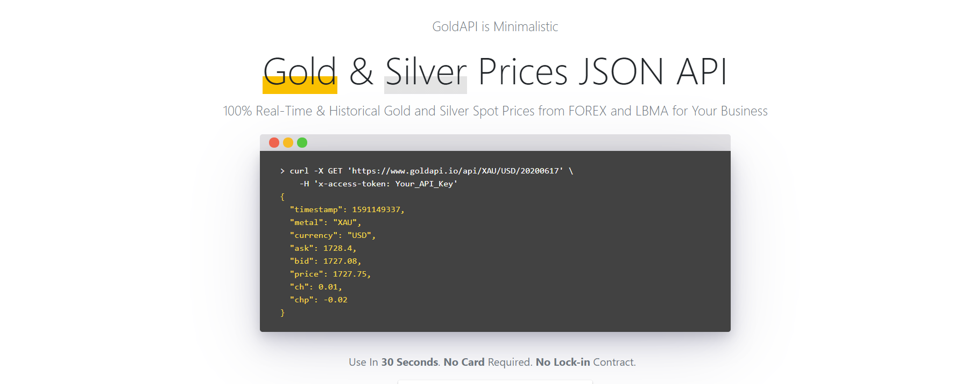
GoldAPI
goldapi.io
Weekly Gold Prices

Slide 10
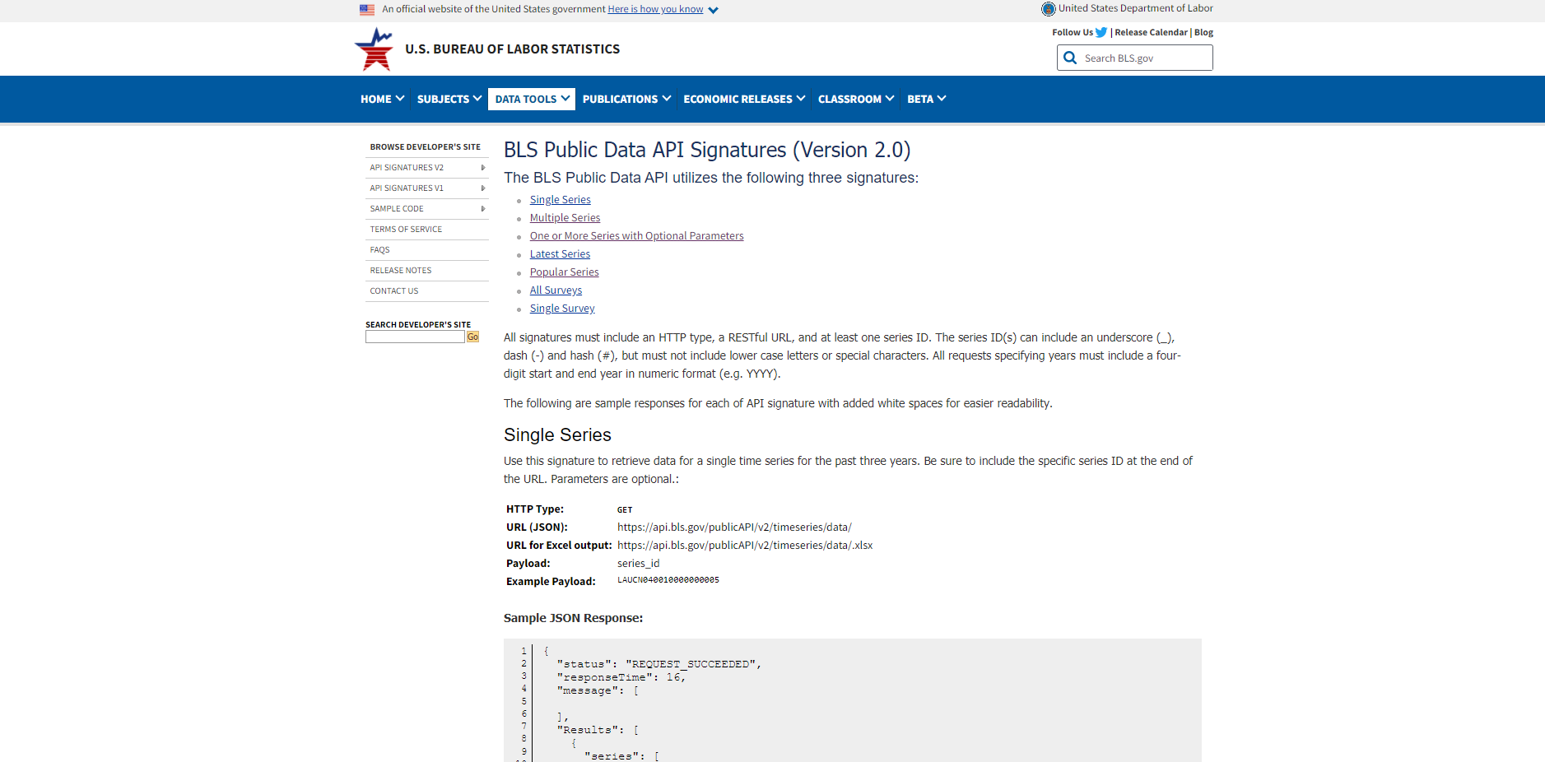
Bureau of Labor Statistics
Bls.gov/developers/api_signature_v2
Monthly inflation data

Slide 11
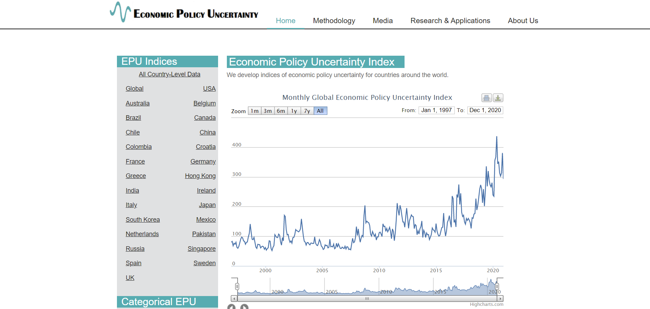
Economic Policy Uncertainty
policyuncertainty.com
Monthly Uncertainty Indices (multiple)
Downloadable tables

Slide 12
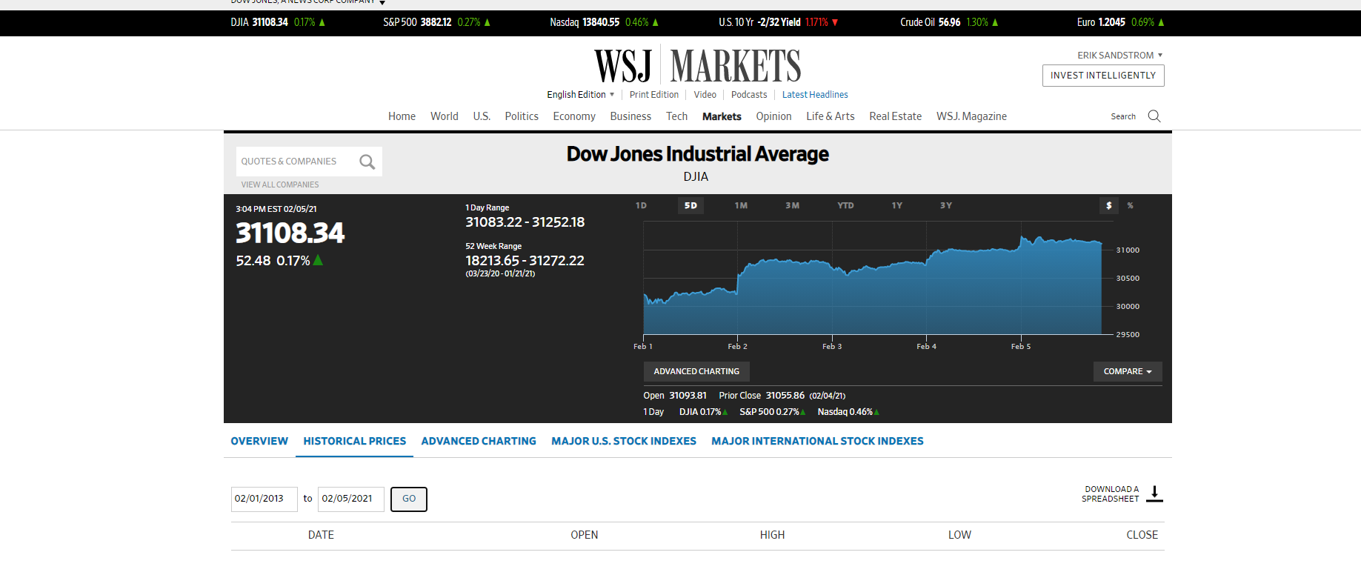
Wall Street Journal
Wsj.com/market-data
Daily Stock Market Closings (DJIA & NASDAQ)
Downloadable tables

Slide 13

Special Shout-Out: AlphaVantage
Financial Market Data API

Slide 14
Data Cleaning and Organization
Tests for null values, extreme outliers
Daily, weekly and monthly data
Date Timestamps
2021-02-01T00:00:00Z
Y2021M02
1/30/2021
2021-02-01
2021-02
Merge DataFrames, re-check integrity
Create sub-DataFrames

Slide 15
Exploration
Now it gets fun…

Slide 16
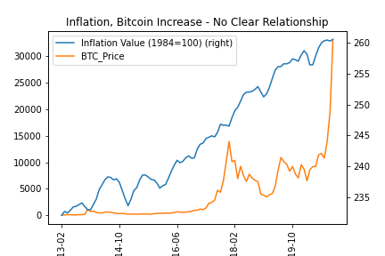
Bitcoin vs Inflation

Slide 17
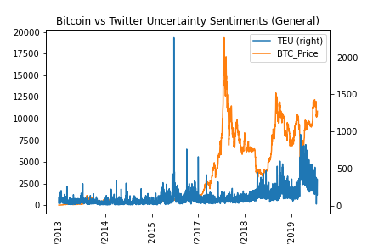
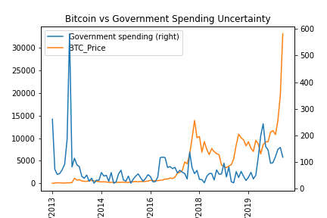
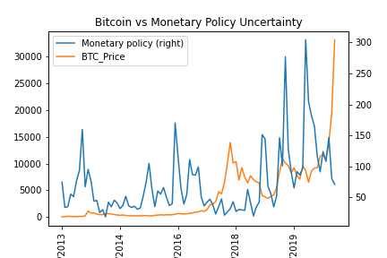
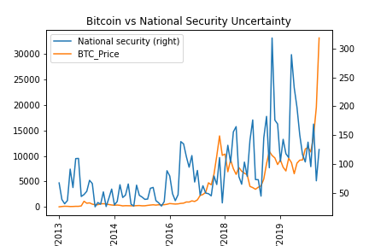
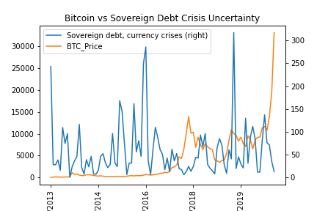
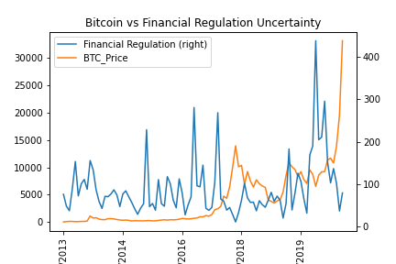
Bitcoin vs Various Uncertainty

Slide 18
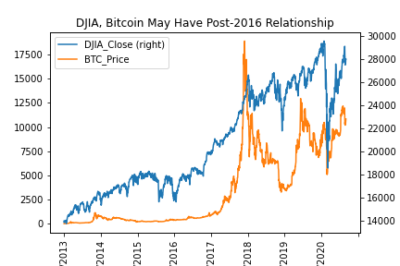
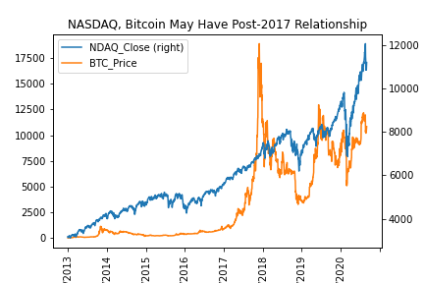
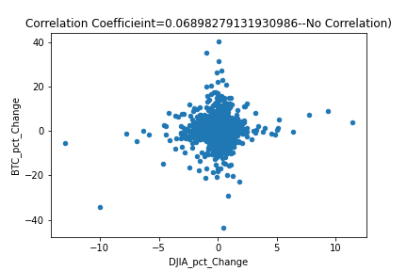
Bitcoin vs Stock Market

Slide 19
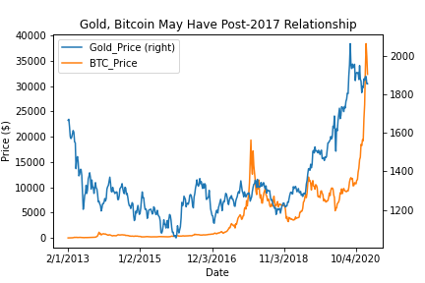
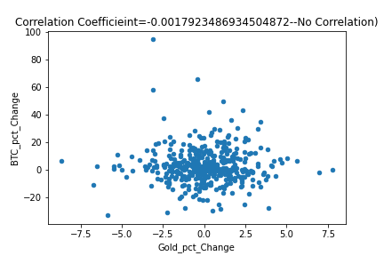
Bitcoin Prices vs Gold

Slide 20
Deeper Analysis

Slide 21
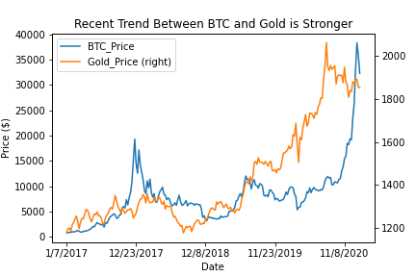
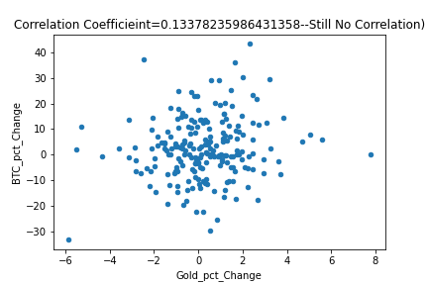
Recent Bitcoin and Gold Trends

Slide 22
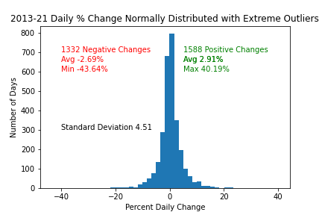
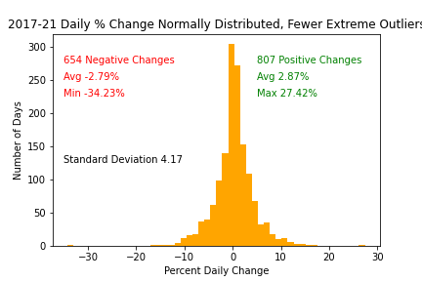
Bitcoin is becoming less volatile

Slide 23
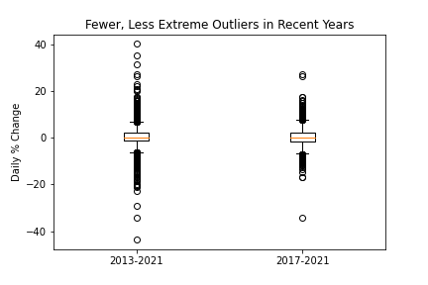
Another look: Bitcioin’s ups downs

Slide 24
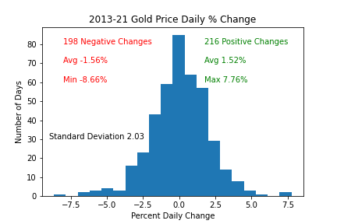
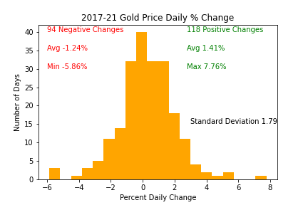
…but it’s still more volatile than Gold

Slide 25
Conclusions
How do Bitcoin prices respond to inflation?
They don’t; at least not to CPI
Are people using Bitcoin as a hedge against uncertainty, and regulation?
It appears so, but my evidence is inconclusive
Does Bitcoin mirror the stock market?
It appears so, but my evidence is inconclusive
Are Bitcoin trends similar to gold trends?
The similarities appear to be growing stronger
Additionally…
Bitcoin has become less volatile over time

Slide 26
Difficulties
Scope
Dates – format, leap years, scales

Slide 27
Further Analysis
BTC vs Inflation expectations
Comparison against M1, M2, M3
Lagging indicators
Twitter sentiments specific to Bitcoin
Other media and social media, too
More different Cryptocurrencies
How is Bitcoin being used?
World news events around each peak and valley

Slide 28
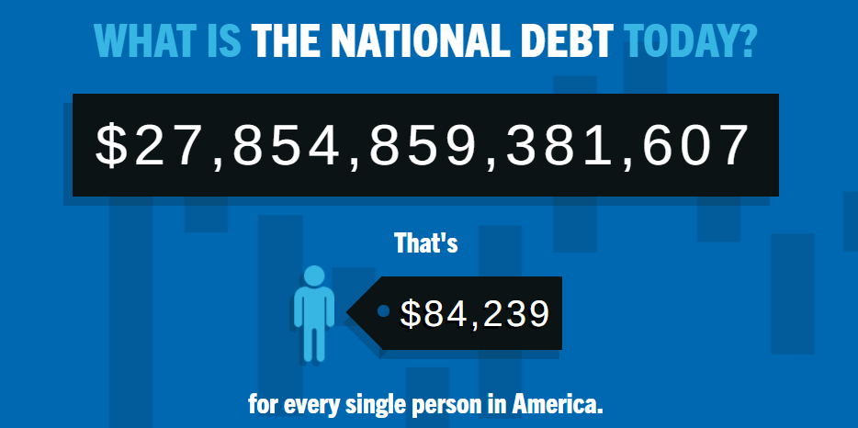
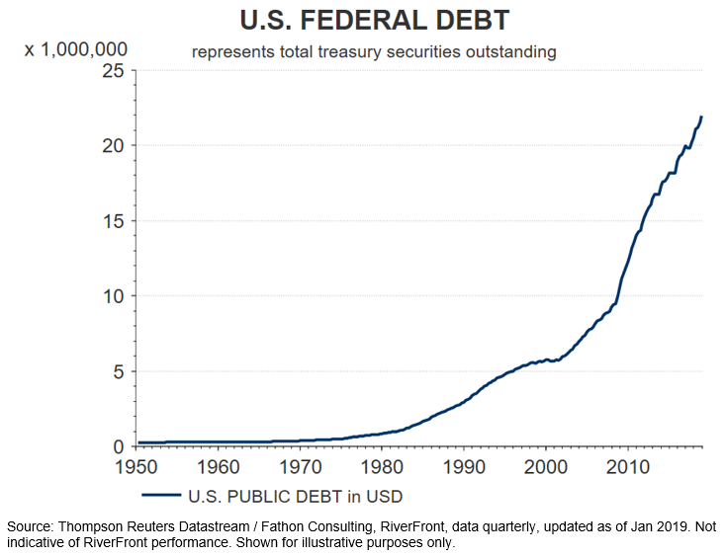
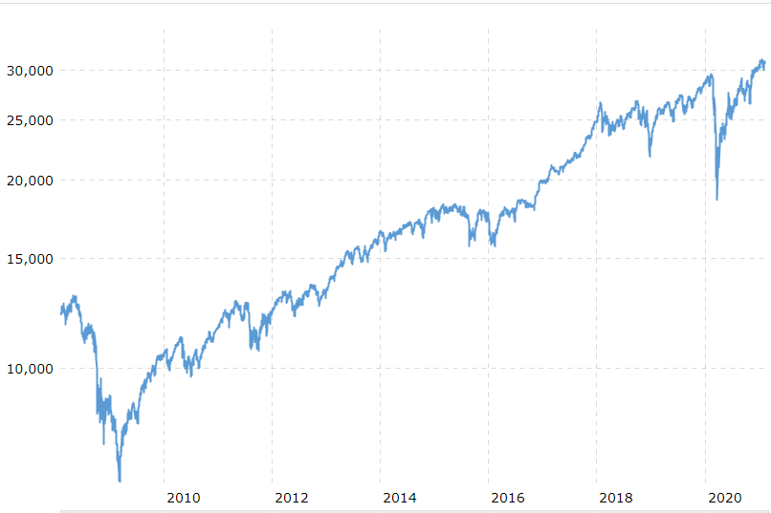
Forecast
Cryptocurrencies will continue to climb
Cryptocurrency volatility will decrease
DJIA
Source: macrotrends.com
Source: etftrends.com

Slide 29
Thanks for listening!
Questions??

